Slide 1





GCC Team 2: SpaceJunkies
I2C and Bluetooth Misadventures
By: Irwin Estrada Fernandez, Justin Thomas, Adrian Jimenez, Caden Hess, James Petersen

Slide 2





The Junkies!
Justin Thomas
James Petersen
EE Major
Payload Design and Assembly
Adrian Jimenez
Electrical Engineering Major
Responsible For: Software
Irwin Estrada Fernandez
- EE Major
- Responsible
For: Leading and debugging Payload issues
Caden Hess
EE Major
Responsible For: Temp I2C, RumCam Dev
AI & ML Major
Radio Man I2C

Slide 3
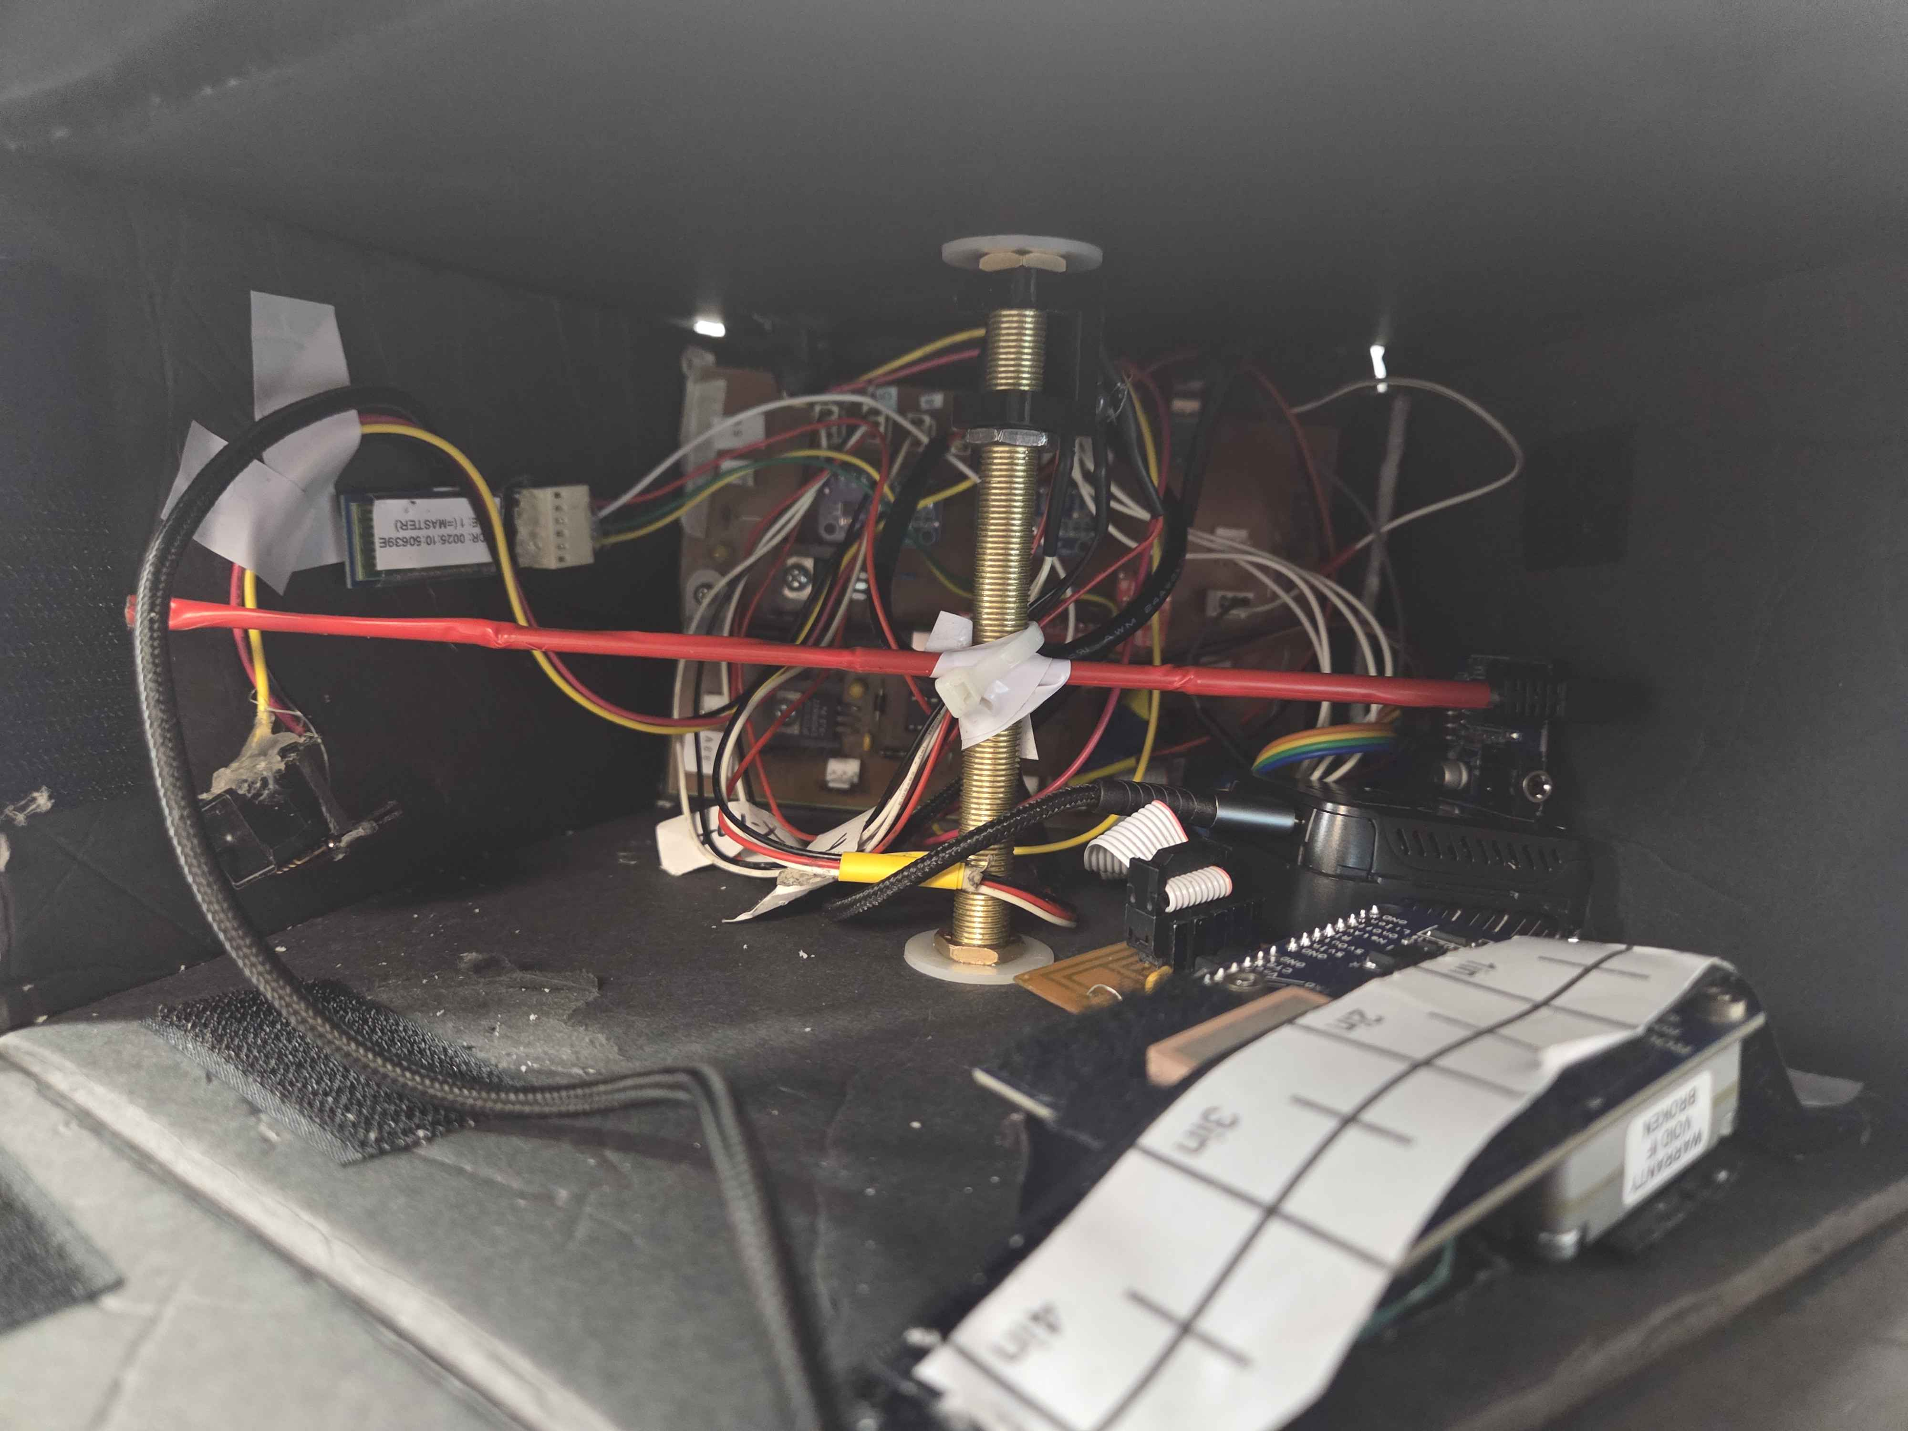
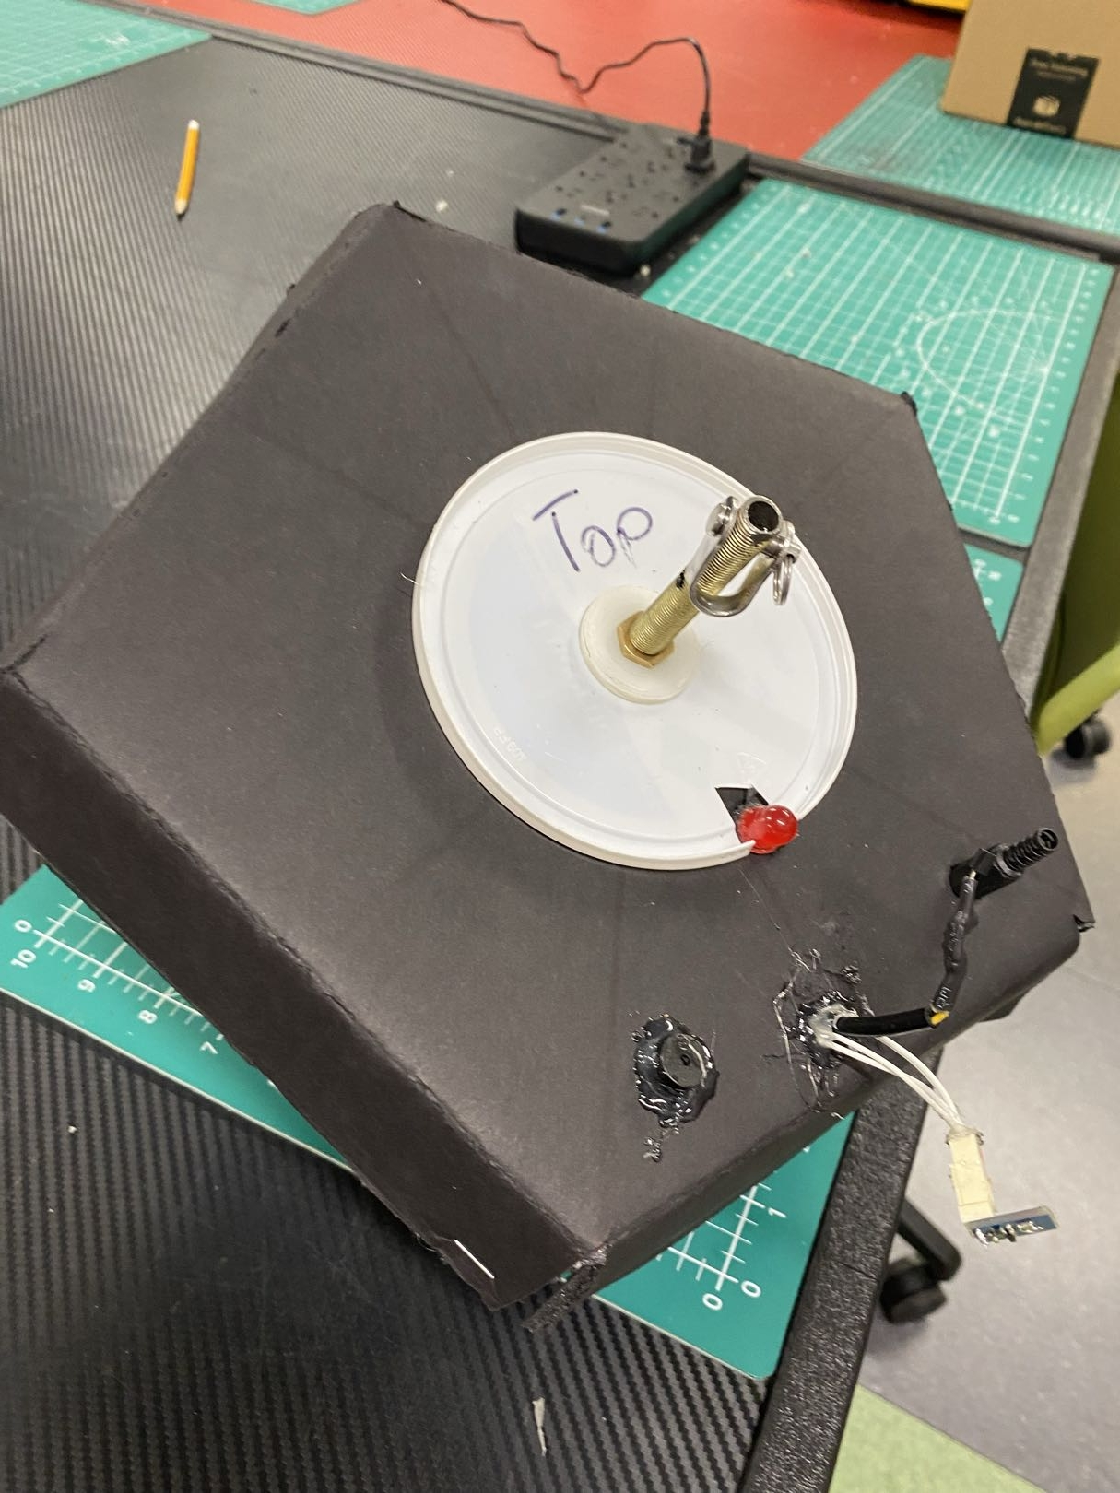
The Payload!!!
Here’ s a look at the inside of our payload
New Gadgets include:
I2C Temperature and Humidity Sensor
(AHT20) I2C Radio Receiver
Bluetooth Transmitter (HC05),
Iridium Modem for satellite coms

Slide 4
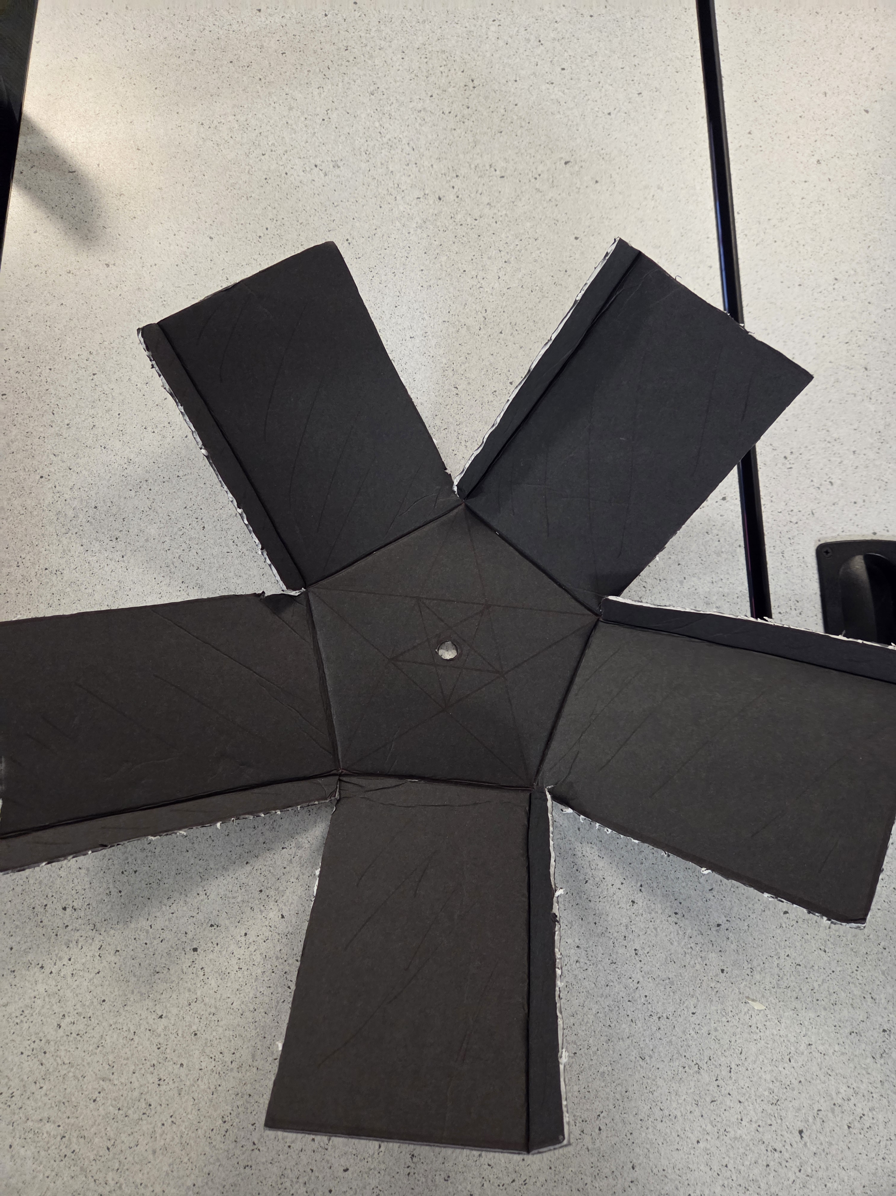
Construction!!
Made primarily of foamboard.
Walls are reinforced with Velcro.
Omnidirectional access to the interior of the payload.
Previous design only had one access point
Inspired by flowers.
Payload was thoroughly tested

Slide 6
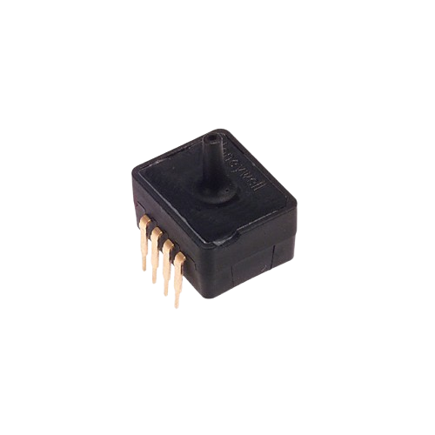
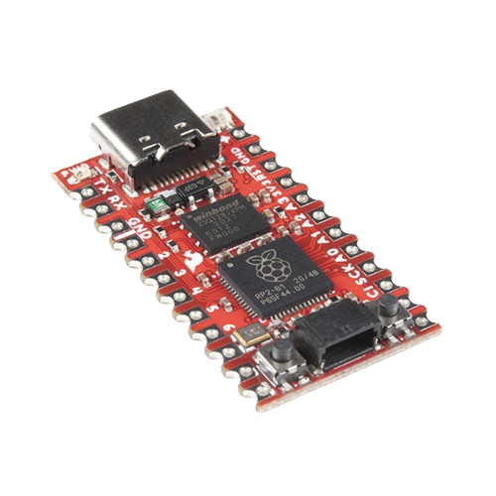
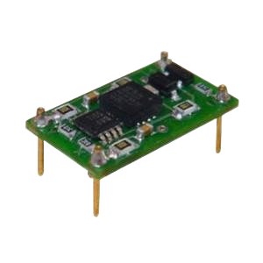
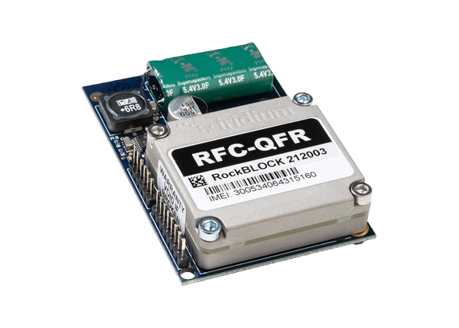
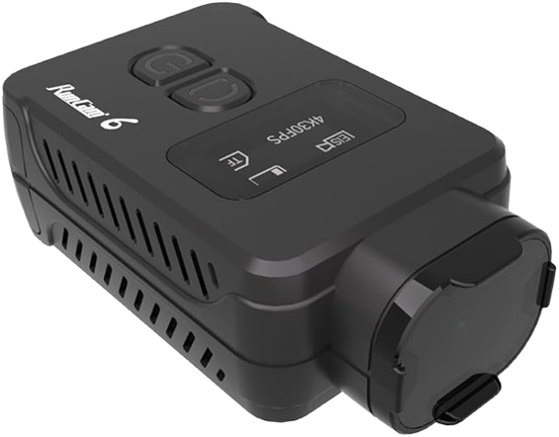
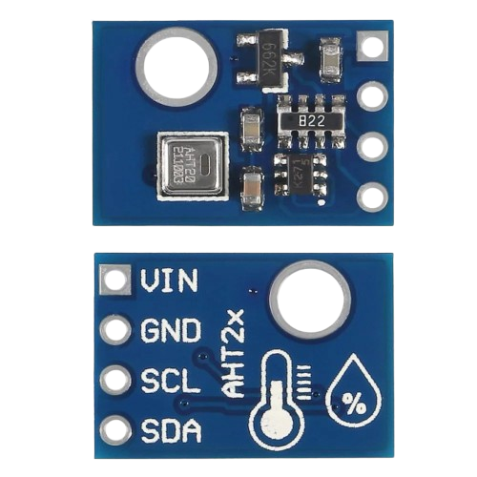
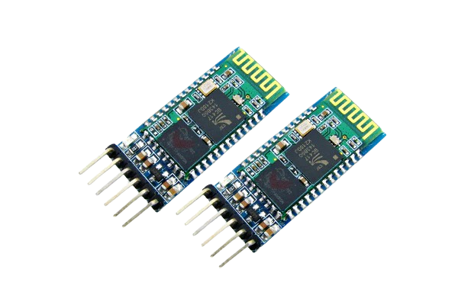
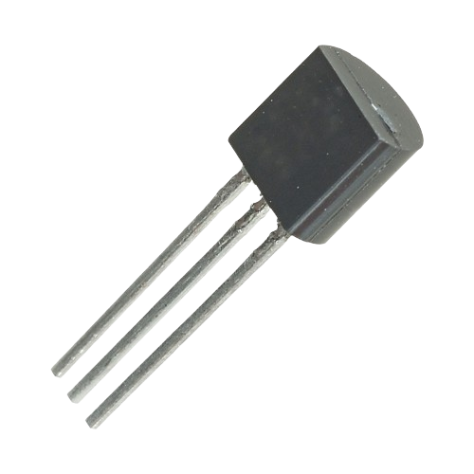
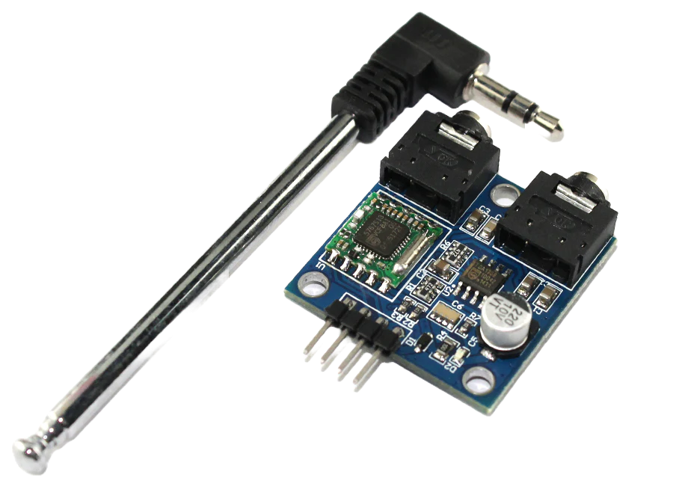
Shopping List (Sensors and Transmitters)
Pressure (ASDX015)
Pro Micro Raspberry Pi 2040
Accelerometer (X & Y) (DE-ACCM6G)
Iridium Modem
RunCam 6 Camera
2 Temperature sensors (TMP36GT9Z) External and Internal
Bluetooth Transmitter (HC05),
I2C Temperature and Humidity Sensor (AHT20)
I2C Radio Receiver(TEA5767)

Slide 7
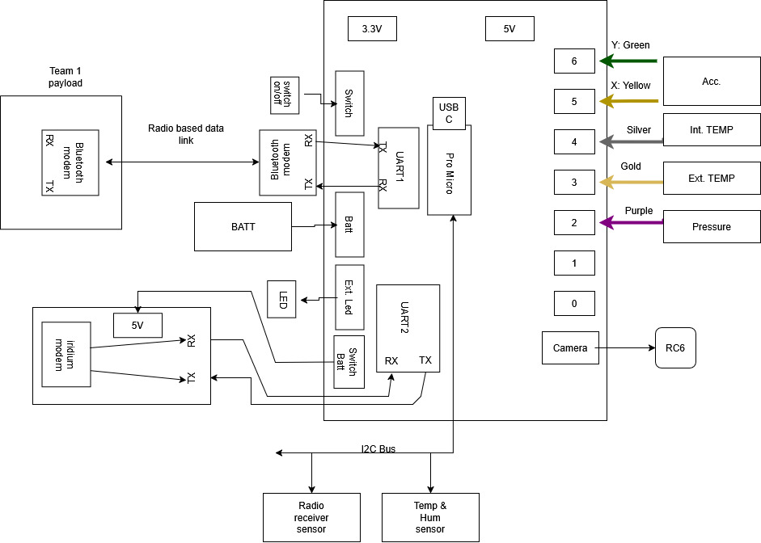
FDR system block diagram

Slide 8
Inter-payload Communication
Every 2 seconds the “Slave” Is Polled using a RX byte (0x01).
The “Slave” responds to the command by sending back a filled array with GNSS, Analog Battery, and a computed CRC byte.
Validated Data is Stored on the “Master” board payload in the array Array[].
If the Slave fails to respond. We retry once again and then retry on the next loop.
Team 2
SpaceJunkies
“Master”
Team 1
State Penitentiary
“Slave”
Transmit
(0X01)
Request
(0X01)

Slide 9
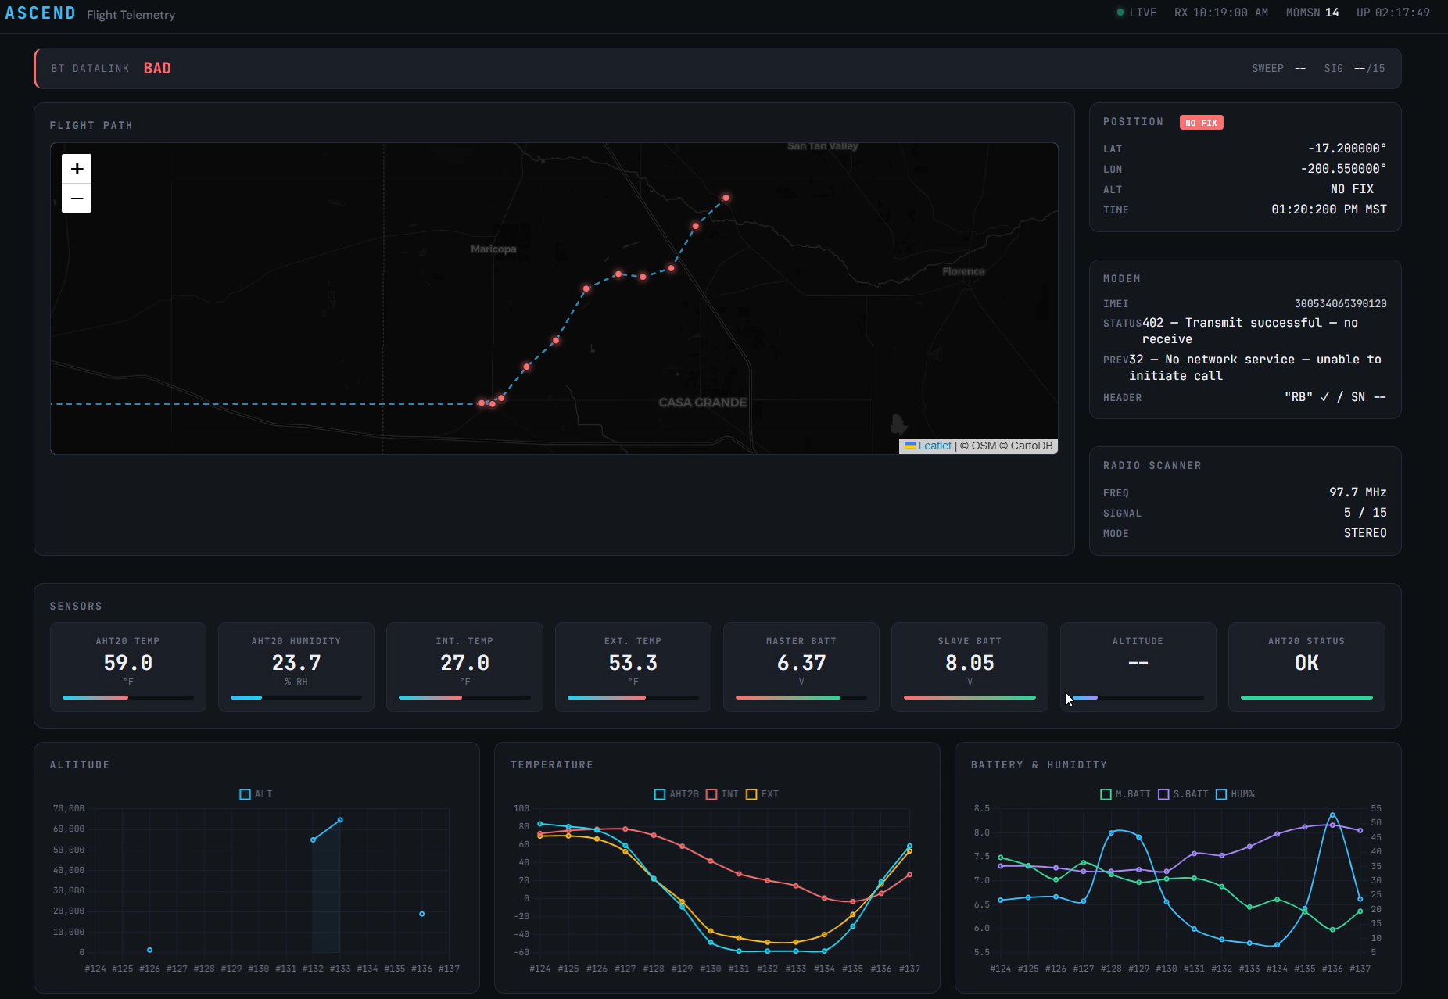
Telemetry Dashboard Overview
Receives transmissions from the iridium modem every 5 minutes.
Receives:
  GPS
  AHT20 Temp & Humidity
  Analog Int & Ext Temp
  Battery Voltages
  Bluetooth datalink status
The Features
Graphical UI
Map Plotting
BT Datalink Status Bar
Latest Analog and I2C Data

Slide 10
I2C Temperature & Humidity Sensor (AHT20) and Radio Receiver
The AHT20 sensor measures temperature and humidity.
- This temperature data was compared to analog data.
The radio receiver was used to generate a 2.5D station signal strength heatmap correlating radio data with the balloon's flight path and altitude.

Slide 11
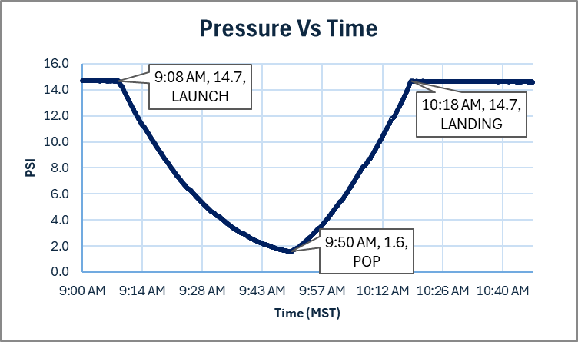
Pressure Graph

Slide 12
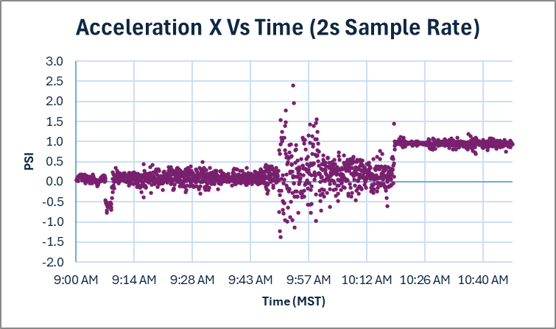
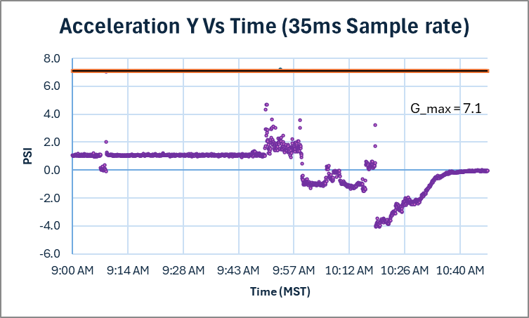
X & Y Acceleration Graph

Slide 13
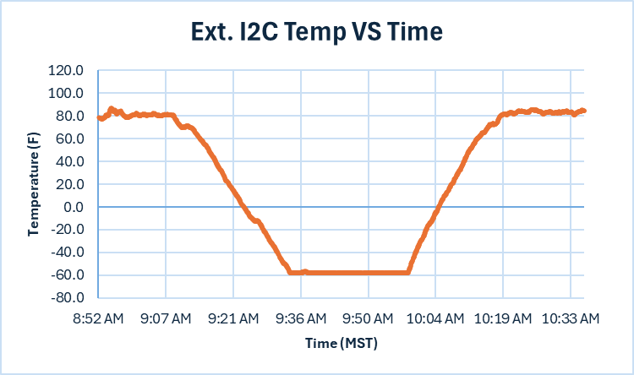
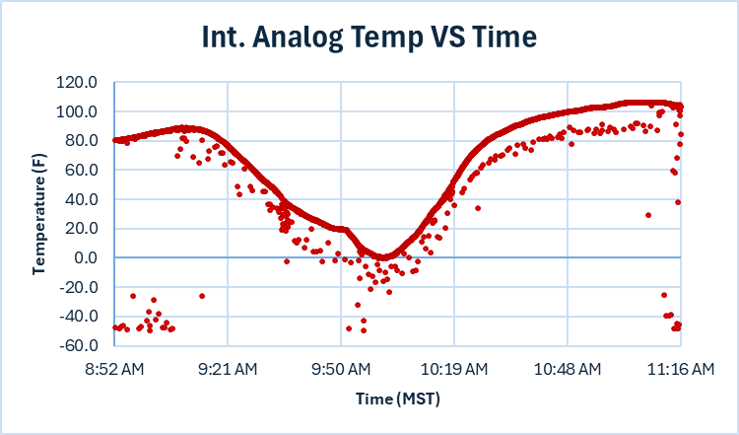
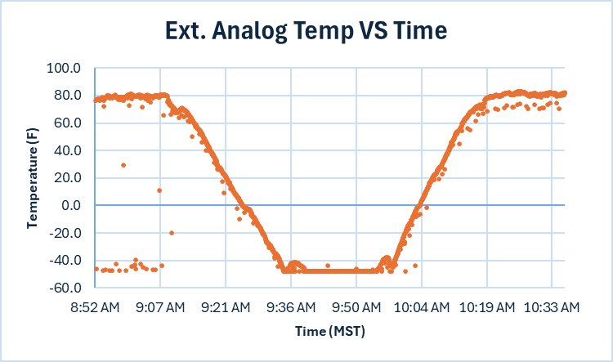
Temperature Data

Slide 14
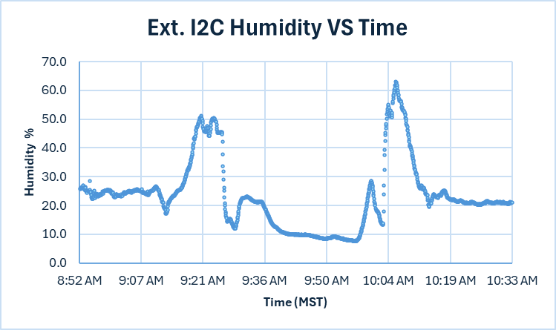
I2C Humidity Graph

Slide 15
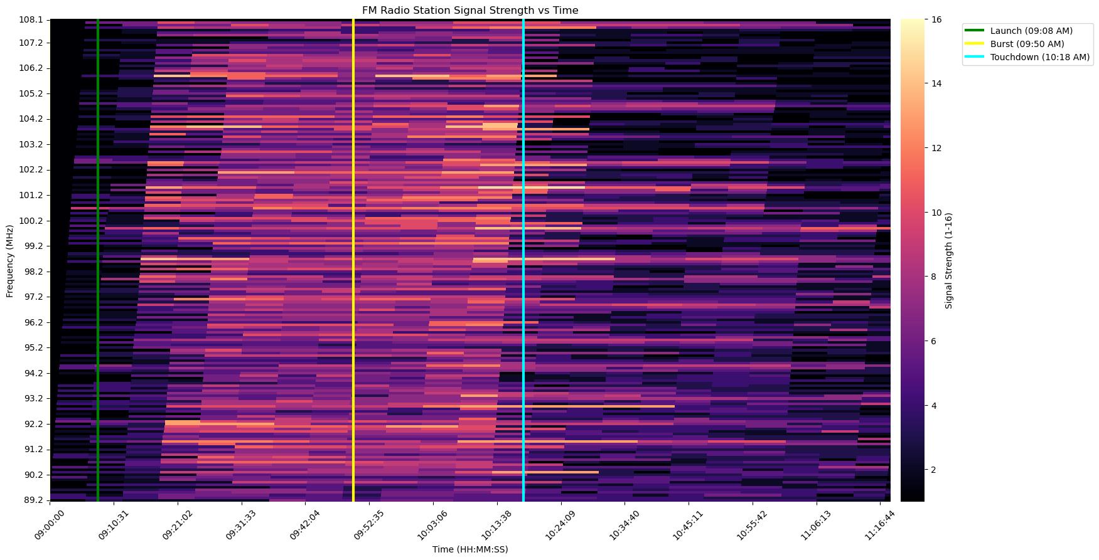
Signal Strength Heatmap

Slide 16



Slide 17

Thank you
ANSR, Michelle Coe, Dr Frank, Rick Sparber, For helping us become better engineers!!!

